Slide 1
Multiple Linear Regression Analysis of the Demand for Beef in the United States
Michael Streyle, Matt Foundos, Carly Mester

Slide 2
Predicting Beef Consumption, 1965-2000
Using a data set of Beef Consumption from 1965 to 2000, our objective was to create a model that we could use to predict the demand of beef
The research questions we would like to answer from these data are as follows
What are the most influential variables when trying to predict beef demand?
How precise are our predictions?

Slide 3
Response and Predictor Variables
Response variable
Beef Consumption – per capita in pounds
Predictor variables in the data set were
Year: calendar year
ChickPrice: Chicken Retail Price in cents per pound
BeefPrice: Beef Retail Price in cents per pound
CPI: Consumer Price Index (CPI) for food
DPI: Disposable Personal Income per capita in dollars
RealChickPrice: Inflation-adjusted Chicken Retail Price in cents per pound
RealBeefPrice: Inflation-adjusted Beef Retail Price in cents per pound
RealDPI: Inflation-adjusted Disposable Personal Income per capita in dollars
(RDPI-Mean)^sq: The square of the difference between Inflation-adjusted Disposable Personal Income per capita and its mean
myRealDPIsq : We created this variable because the (RDPI-Mean)^sq variable has a computational error, so this variable replaces it
There are 36 years in the data set

Slide 4
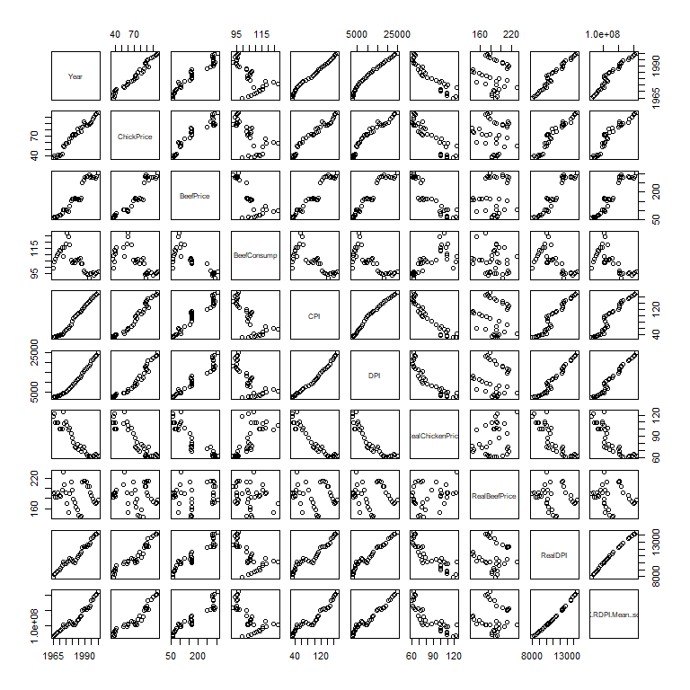
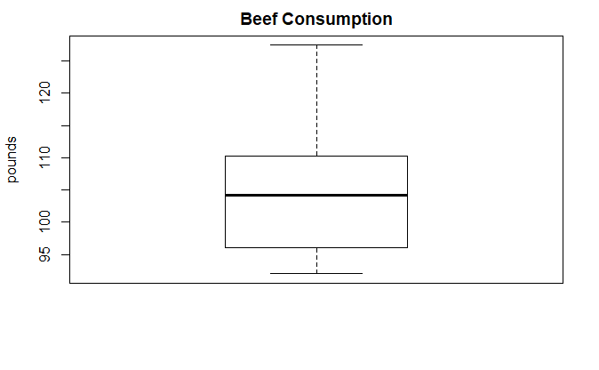
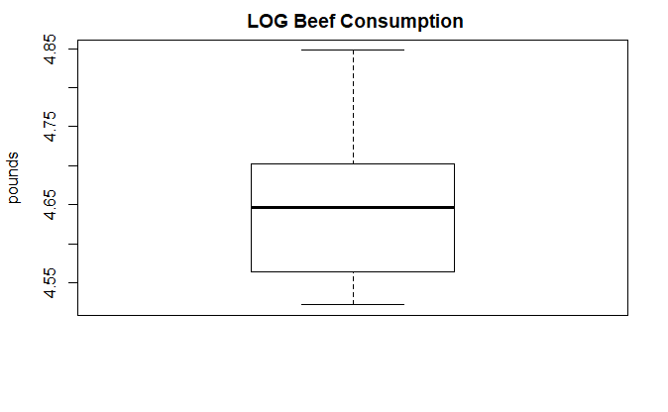
Distributions and Correlations
The distribution of Beef Consumption is somewhat right-skewed. The boxplot of the log of beef consumption is not much better, but the original data is not skewed enough to worry about. None of the predictor variables needed to be transformed (not shown).
The scatter plot matrix shows quite a few linear relationships, mainly due to the nature of our data. Many of the variables relate to each other or are derived from another. However, something to note is that ChickPrice and BeefPrice seem to have a linear relationship.

Slide 5
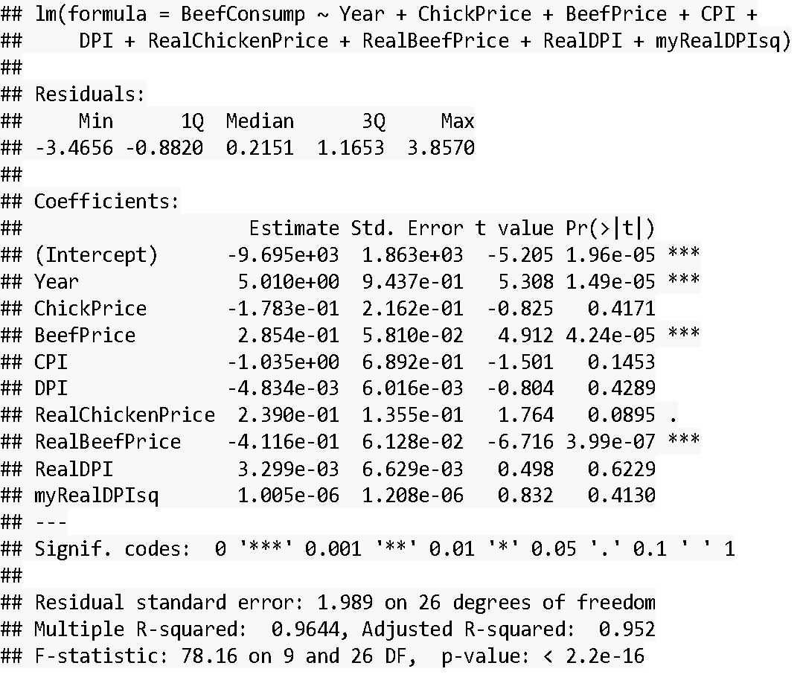
First-Order Model
Response is Beef Consumption (Demand)
All predictors were included in the First-Order model
The significant predictors were Year, BeefPrice, and RealBeefPrice
We were somewhat surprised that nothing with Chicken was significant
The standard error is 1.98 with the range of the data being 90-130. The r-squared value is already very high at 0.9644 (Adjusted: 0.952)

Slide 6
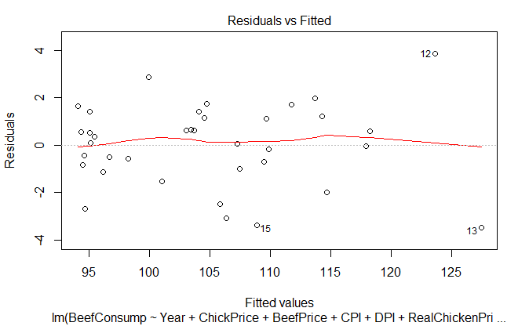
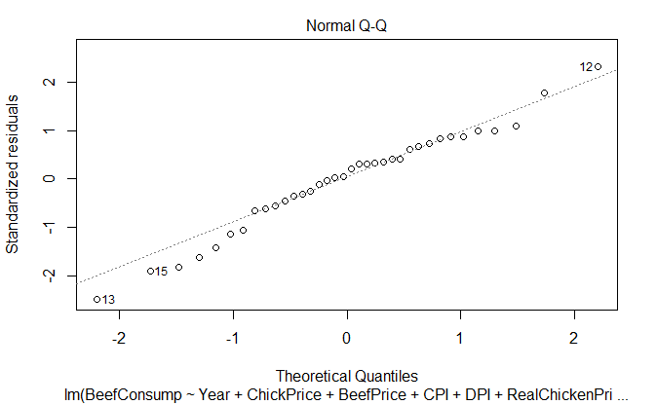
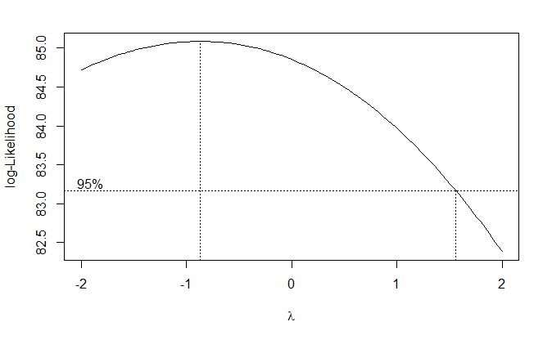
First-Order Model
Residual analysis
The residuals vs fitted plot is already looking quite good, showing constant variance.
Residuals close to a normal distribution with only some moderate departures from a normal distribution.
Box-Cox Analysis
The Box-Cox analysis was inconclusive, showing that we don’t need to transform BeefConsump
Box-Cox Plot

Slide 7
Backwards Elimination from First-Order Model
Using automated backwards elimination on the first order model, we formed a new model, myfit4, which fit the data very well.
All the variables are significant
1.899 residual standard error and 0.9625 R² value

Slide 8
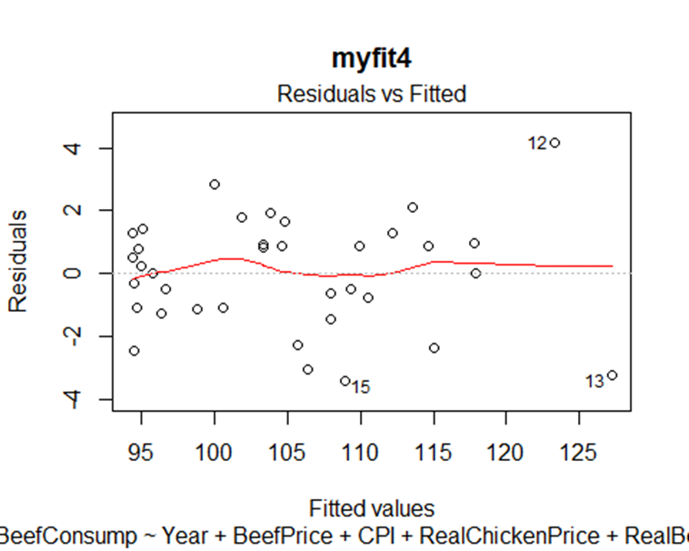
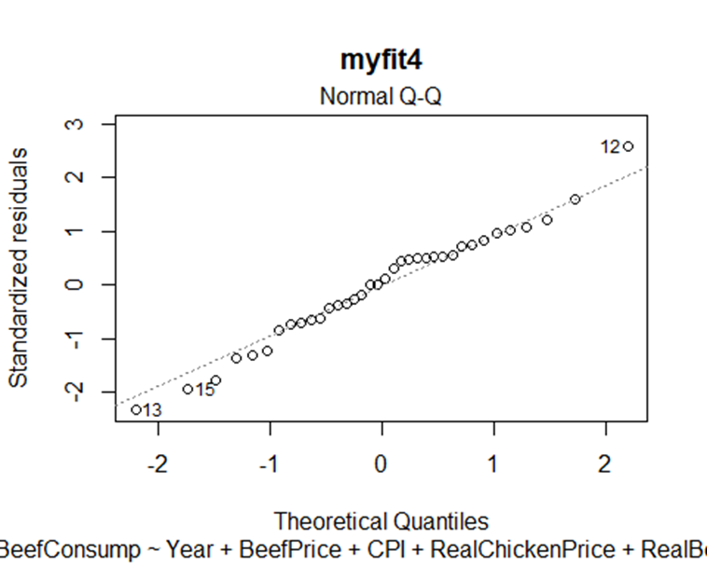
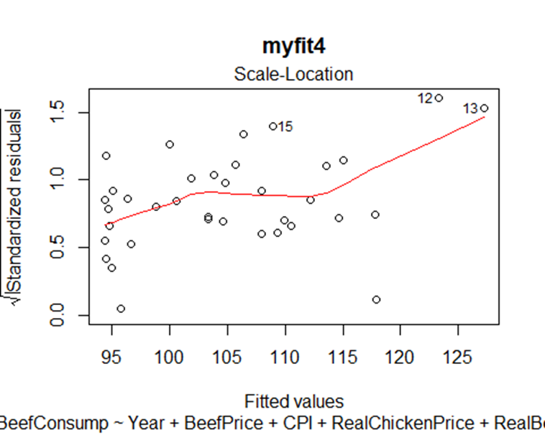
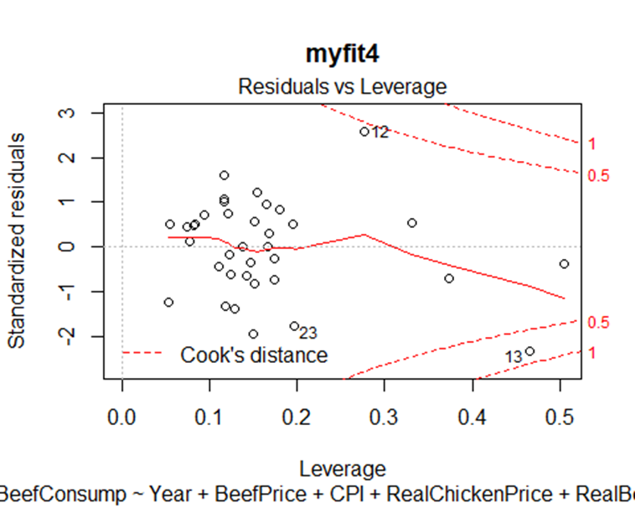
Analysis of myfit4
Residuals vs Fitted plot looks very good
Distribution looks very close to normal
The scale location plot shows there isn’t perfectly constant variance
None of the points go past Cook’s distance suggesting removal of the points with the highest leverage would not significantly change our model.

Slide 9
Model with Interaction Effects
Centered continuous variables and created a model with all interaction effects called fit.int
Then used elimination process with both directions to find the best model
Our BeefPrice was removed, but three interaction effects involving BeefPrice were kept
We then removed these three interaction effects and tested the model with the interaction effects against a reduced model without the interaction effects
The full model with interaction effects fits better than the reduced model. The difference between models has a p-value of 0.0007566. While both of these models fit very well, neither fit as well as our original backwards elimination model (myfit4)

Slide 10
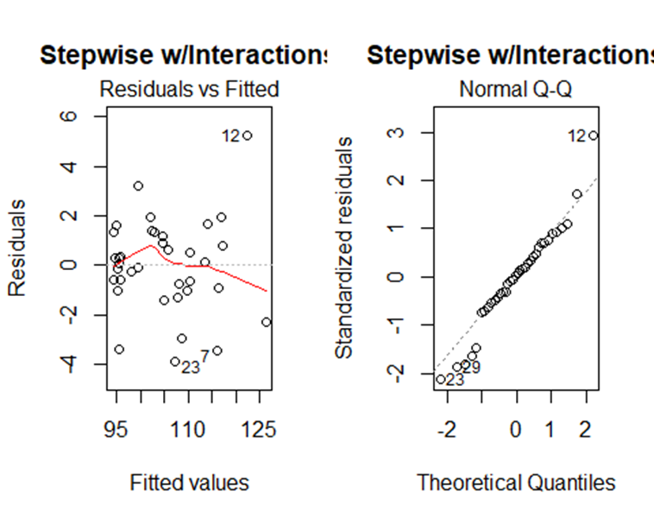
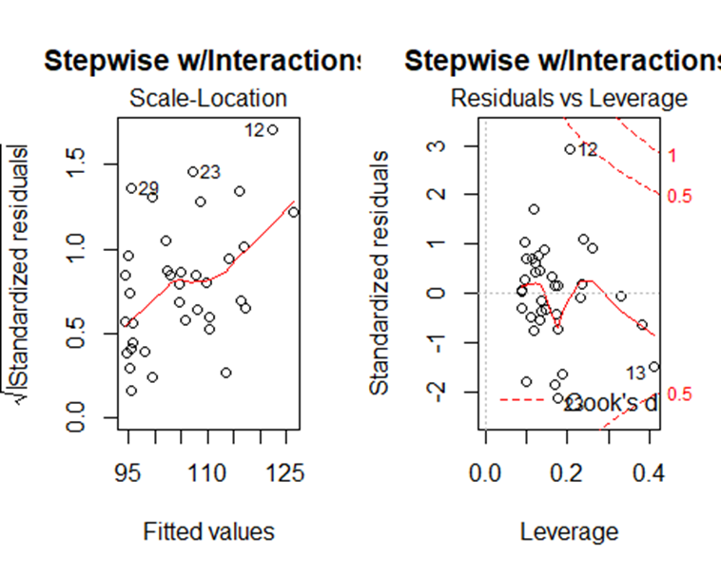
Final Model
Residual and Influence analysis
No obvious patterns
Decently constant variance but not perfect
Distribution close to normal
Some points have high leverage but none of them go past cook’s distance, so removal will not affect the model

Slide 11
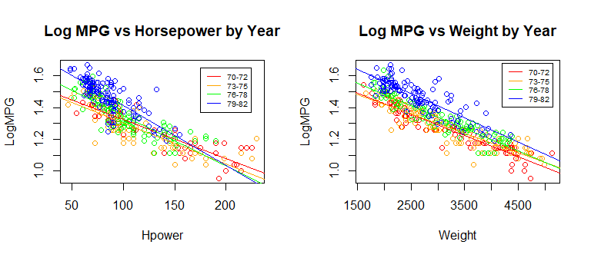
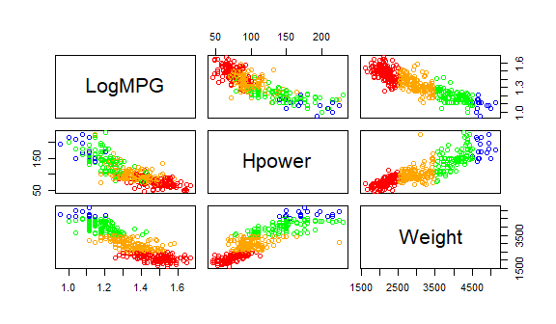
Final Model – Interaction Effects
Log MPG vs Horsepower by Weight
The Log MPG vs Horsepower slope is steeper for newer cars, and not as steep for older cars (p = 0.0007)
The Log MPG vs Weight slope is slightly steeper for newer cars, and not as steep for older cars. This interaction effect is less significant (p = 0.02).
The Log MPG vs Horsepower slope is steeper for lighter weight cars, and not as steep for heavier cars (p < 0.0001).

Slide 12
Example Predictions Using myfit4 vs step.int
With prediction level set at 95%, the following are some predictions.
Difference using step.int
Difference using myfit4

